Slide 1
Architectural Design Unit-III
Prepared by: Neha Tripathi

Slide 2
Topics covered
Architectural views
Architectural patterns

Slide 3
Software architecture
The design process for identifying the sub-systems making up a system and the framework for sub-system control and communication is architectural design.
The output of this design process is a description of thesoftware architecture.

Slide 4
Architectural design
An early stage of the system design process.
Represents the link between specification and design processes.
Often carried out in parallel with some specification activities.
It involves identifying major system components and their communications.

Slide 5
Use of architectural models
As a way of facilitating discussion about the system design
A high-level architectural view of a system is useful for communication with system stakeholders and project planning because it is not cluttered with detail. Stakeholders can relate to it and understand an abstract view of the system. They can then discuss the system as a whole without being confused by detail.
As a way of documenting an architecture that has been designed
The aim here is to produce a complete system model that shows the different components in a system, their interfaces and their connections.

Slide 6
Architectural views
What views or perspectives are useful when designing and documenting a system’s architecture?
What notations should be used for describing architectural models?
Each architectural model only shows one view or perspective of the system.
It might show how a system is decomposed into modules, how the run-time processes interact or the different ways in which system components are distributed across a network. For both design and documentation, you usually need to present multiple views of the software architecture.

Slide 7
4 + 1 view model of software architecture
A logical view, which shows the key abstractions in the system as objects or object classes.
A process view, which shows how, at run-time, the system is composed of interacting processes.
A development view, which shows how the software is decomposed for development.
A physical view, which shows the system hardware and how software components are distributed across the processors in the system.
Related using use cases or scenarios (+1)

Slide 8
Architectural patterns
Patterns are a means of representing, sharing and reusing knowledge.
An architectural pattern is a stylized description of good design practice, which has been tried and tested in different environments.
Patterns should include information about when they are and when the are not useful.
Patterns may be represented using tabular and graphical descriptions.

Slide 9
Layered architecture
Used to model the interfacing of sub-systems.
Organises the system into a set of layers (or abstract machines) each of which provide a set of services.
Supports the incremental development of sub-systems in different layers. When a layer interface changes, only the adjacent layer is affected.
However, often artificial to structure systems in this way.

Slide 10
The Layered architecture pattern
Name | Layered architecture
Description | Organizes the system into layers with related functionality associated with each layer. A layer provides services to the layer above it so the lowest-level layers represent core services that are likely to be used throughout the system. See Figure 6.6.
Example | A layered model of a system for sharing copyright documents held in different libraries, as shown in Figure 6.7.
When used | Used when building new facilities on top of existing systems; when the development is spread across several teams with each team responsibility for a layer of functionality; when there is a requirement for multi-level security.
Advantages | Allows replacement of entire layers so long as the interface is maintained. Redundant facilities (e.g., authentication) can be provided in each layer to increase the dependability of the system.
Disadvantages | In practice, providing a clean separation between layers is often difficult and a high-level layer may have to interact directly with lower-level layers rather than through the layer immediately below it. Performance can be a problem because of multiple levels of interpretation of a service request as it is processed at each layer.

Slide 11
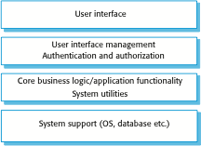
A generic layered architecture

Slide 12
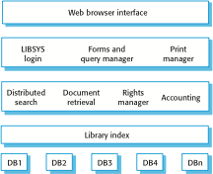
The architecture of the LIBSYS system

Slide 13
Repository architecture
Sub-systems must exchange data. This may be done in two ways:
Shared data is held in a central database or repository and may be accessed by all sub-systems;
Each sub-system maintains its own database and passes data explicitly to other sub-systems.
When large amounts of data are to be shared, the repository model of sharing is most commonly used a this is an efficient data sharing mechanism.

Slide 14
The Repository pattern
Name | Repository
Description | All data in a system is managed in a central repository that is accessible to all system components. Components do not interact directly, only through the repository.
Example | Figure 6.9 is an example of an IDE where the components use a repository of system design information. Each software tool generates information which is then available for use by other tools.
When used | You should use this pattern when you have a system in which large volumes of information are generated that has to be stored for a long time. You may also use it in data-driven systems where the inclusion of data in the repository triggers an action or tool.
Advantages | Components can be independent—they do not need to know of the existence of other components. Changes made by one component can be propagated to all components. All data can be managed consistently (e.g., backups done at the same time) as it is all in one place.
Disadvantages | The repository is a single point of failure so problems in the repository affect the whole system. May be inefficiencies in organizing all communication through the repository. Distributing the repository across several computers may be difficult.

Slide 15
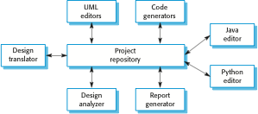
A repository architecture for an IDE

Slide 16
Client-server architecture
Distributed system model which shows how data and processing is distributed across a range of components.
Can be implemented on a single computer.
Set of stand-alone servers which provide specific services such as printing, data management, etc.
Set of clients which call on these services.
Network which allows clients to access servers.

Slide 17
The Client–server pattern
Name | Client-server
Description | In a client–server architecture, the functionality of the system is organized into services, with each service delivered from a separate server. Clients are users of these services and access servers to make use of them.
Example | Figure 6.11 is an example of a film and video/DVD library organized as a client–server system.
When used | Used when data in a shared database has to be accessed from a range of locations. Because servers can be replicated, may also be used when the load on a system is variable.
Advantages | The principal advantage of this model is that servers can be distributed across a network. General functionality (e.g., a printing service) can be available to all clients and does not need to be implemented by all services.
Disadvantages | Each service is a single point of failure so susceptible to denial of service attacks or server failure. Performance may be unpredictable because it depends on the network as well as the system. May be management problems if servers are owned by different organizations.

Slide 18
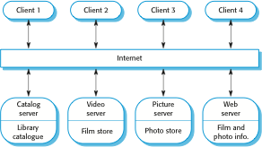
A client–server architecture for a film library

Slide 19
Pipe and filter architecture
Functional transformations process their inputs to produce outputs.
May be referred to as a pipe and filter model (as in UNIX shell).
Variants of this approach are very common. When transformations are sequential, this is a batch sequential model which is extensively used in data processing systems.
Not really suitable for interactive systems.

Slide 20
The pipe and filter pattern
Name | Pipe and filter
Description | The processing of the data in a system is organized so that each processing component (filter) is discrete and carries out one type of data transformation. The data flows (as in a pipe) from one component to another for processing.
Example | Figure 6.13 is an example of a pipe and filter system used for processing invoices.
When used | Commonly used in data processing applications (both batch- and transaction-based) where inputs are processed in separate stages to generate related outputs.
Advantages | Easy to understand and supports transformation reuse. Workflow style matches the structure of many business processes. Evolution by adding transformations is straightforward. Can be implemented as either a sequential or concurrent system.
Disadvantages | The format for data transfer has to be agreed upon between communicating transformations. Each transformation must parse its input and unparse its output to the agreed form. This increases system overhead and may mean that it is impossible to reuse functional transformations that use incompatible data structures.

Slide 21
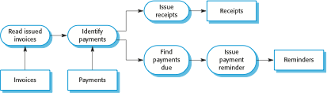
An example of the pipe and filter architecture

